Slide 1
Atoms, Elements, compounds, mixtures & molecules
Year 8, term 1 2017

Slide 2
Atoms & Elements
2500 years ago a teacher named Democritus who lived in ancient Greece developed the theory that the world was made up of tiny particles (which he called “atomos” = unable to be divided).
2400 years later we now know them as atoms.
Each element is made of its own particular kind of atom. For example; Gold only contains gold atoms, carbon only contains carbon atoms and so on.
But what makes atoms different from each other?

Slide 3

Inside the Atom
Atoms are made up of 3 subatomic particles:
Protons – positively charged particles found in the nucleus (centre)
Neutrons – neutral particles found in the nucleus “glue”
Electrons – negatively charged particles found orbiting the nucleus.
E.g.
Each element has a specific number of protons (called its atomic number) – this is how individual atoms are distinguished from other atoms
.

Slide 4
Elements
Each element has its own atomic number (= number of protons in its nucleus) and can be found on the periodic table.
Elements are represented by a chemical symbol. e.g. C – Carbon, O – oxygen, Au - gold
The periodic table organises all known elements in groups and rows based on their atomic number and common features. – we will look at these more next lesson.

Slide 5
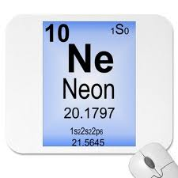
Elements and the Periodic Table
Each element on the periodic table has it’s own place which tells you some information about the element.
Atomic Number = number of protons
Number of protons = Number of electrons
Atomic Mass = the average mass of each element

Slide 6
Elements cont..
The naturally occurring elements are the building blocks of everything in our world (both living and non-living, including you!) It is the way that the different atoms join (bond) together that makes all the different compounds in our world.
Because elements contain all of the same type of atom they can be represented diagrammatically as the same coloured shape, bonded or not bonded to other atoms of the same element.

Slide 7
The Photographic Periodic Table
http://www.periodictable.com/

Slide 8
Compounds
Substances in which the atom(s) of one element are bonded to the atom(s) of another element.
More simply – different types of elements joined together.
The elements that make up a compound are completely different from the compound. E.g. salt
Can be represented diagrammatically as different shapes or coloured shapes joined together..
E.g. Carbon dioxide, water

Slide 9
Compounds – Chemical Formula
Compounds are written as chemical formula
e.g. NaCl, H₂O, CO₂
Chemical formula indicates the type of elements in the compound and how many of each type of atom make up that compound. It is a shorthand way of writing for chemists.

Slide 10
So what is a Molecule?
A molecule is a group of two or more atoms that stick (bond) together.
They can be pure elements or compounds. It is the simplest structural unit of an element or compound.
Molecule of an compound e.g. H₂O
Molecule of an element e.g. O₂

Slide 11
Mixtures
Are made up of two or more elements, two or more compounds or a combination of elements and compounds but they aren’t all bonded together.
The substances that make up mixtures can usually be easily separated from each other (i.e. without a chemical reaction).
E.g. soft drink, sand

Slide 12
Some Common Substances

Slide 13
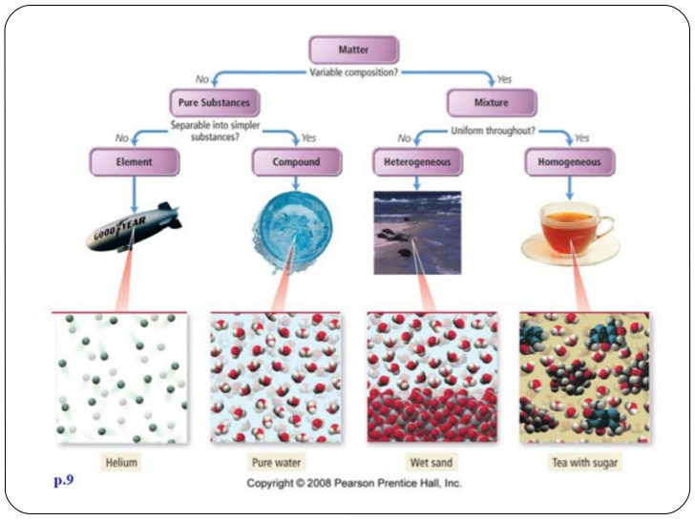
Summary

Slide 14
Practice – Laptops needed
Chemical mix-up game - match Elements, Compounds, and Mixtures
Go to the website above
Enter your name
Click on start
  Drag the item into the correct category
  Correct response earns points
  Need to earn 700 points to pass level one
  Try to pass level one and have go at level two

